Slide 1

Modules Summary Discussion – Q&A
CR 2.1
Private and Confidential

Slide 2

Prepare for the Day with the Elder
1
Copyright: iCare Life Pte. Ltd., Singapore : This document must not be copied or shared or circulated without the consent of iCare Life and/or its affiliates.

Slide 3
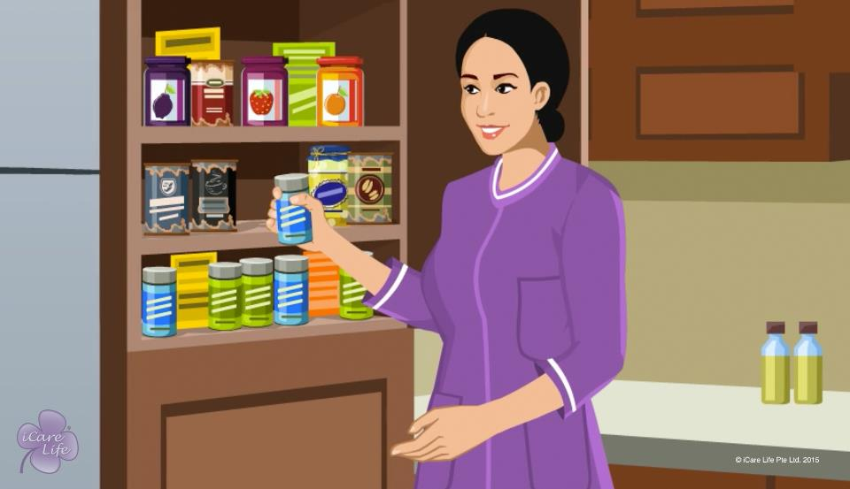
Prepare for the Day with the Elder

Slide 4
Summary
Plan the elder’s meals a day in advance
Every week, create a chart of medicines that the elder needs to have
Check the stock of the medicines; if a medicine is not available, buy it in advance
Ensure that a fresh set of elder’s clothes is available for the next day
If the elder wears diapers, ensure that you have diapers available
Ensure that you make available the materials required for the elder’s hobbies
If you are taking the elder out to a new place, find out the location and the route
Prepare an outing bag ahead of outings
If the elder requires any mobility support, carry it to outings
Take doctor’s appointments in advance; gather and arrange the latest prescriptions and reports before the visit
3
Copyright: iCare Life Pte. Ltd., Singapore : This document must not be copied or shared or circulated without the consent of iCare Life and/or its affiliates.
Notes:
Plan the elder’s meals a day in advance
Every week, create a chart of medicines that the elder needs to have
Check the stock of the medicines; if a medicine is not available, buy it in advance
Ensure that a fresh set of elder’s clothes is available for the next day
If the elder wears diapers, ensure that you have diapers available
Ensure that you make available the materials required for the elder’s hobbies
If you are taking the elder out to a new place, find out the location and the route
Prepare an outing bag ahead of outings
If the elder requires any mobility support, carry it to outings
Take doctor’s appointments in advance; gather and arrange the latest prescriptions and reports before the visit

Slide 5
Post-Module Activity
Planning efficiently
4
Copyright: iCare Life Pte. Ltd., Singapore : This document must not be copied or shared or circulated without the consent of iCare Life and/or its affiliates.
Notes:
Divide the class into two groups. Give the groups a time-limit of 5 minutes to complete the activity. After they complete, ask a representative from each group to present their answers. Encourage inputs and feedback from the other group.
Each group needs to list down the following for the activity given to them:
a) The items to be gathered for the situation
b) Planning to be done beforehand
Activity for Group 1- The elder has to be taken to the hospital for a check-up.
Answer: Take an appointment beforehand. Arrange for the route map, contacts, mode of transport and fee money. Gather the things for outing bag and elder’s mobility support.
Activity for Group 2- Prepare the elder’s favorite meal.
Answer: Check with the elder how do they want it prepared. Find out the ingredients that will be required. Ensure that all the ingredients are available by arranging for funds and shopping on time. Also, confirm when does the elder wish to eat and prepare accordingly.

Slide 6
Any Questions?
5
Copyright: iCare Life Pte. Ltd., Singapore : This document must not be copied or shared or circulated without the consent of iCare Life and/or its affiliates.
Notes:
Q1. Why is preparation for the day’s activities in advance important?
Ans. Advance preparation helps in carrying out duties more efficiently, in an organized manner. It also helps avoid disappointments and last minute rushes.
Q2. How can you make preparations for the day with the elderly?
Ans. Keep your charts updated – for the medication, diet, clinic visit, other activities and noting down the vitals of the elderly. In a few days time of careful preparations of these charts, you will be able to better understand the preparations you need to make to fulfil your duty as a caregiver. Besides this, you keep interacting with the elderly regarding their interests in spending their time.

Slide 7
Creating a Structured Schedule for the Elder
6
Copyright: iCare Life Pte. Ltd., Singapore : This document must not be copied or shared or circulated without the consent of iCare Life and/or its affiliates.

Slide 8
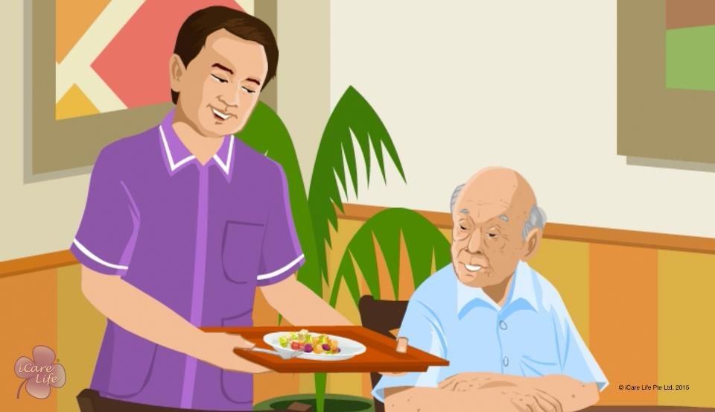
Creating a Structured Schedule

Slide 9
Summary
Observe the elder and note down their physical and mental capabilities, routines and habits, and interests
Based on your observations, create a structured schedule for the elder
Set a wake up time and keep some time for bathing and getting ready
Plan a time for meditation and prayer
Plan several short mealtimes
Plan a time of the day for recreational activities
Plan around 8 hours of rest at night and some time to rest in the day
Include time for physical activity
Plan a time of the day when the elder can socialize
Include a time in the evening for getting ready for dinner and bed
Plan to follow dinner with activities such as spending time with family, watching TV, reading, or meditating
At bedtime, chat with the elder for a few minutes
Remember to be flexible to alter the routine temporarily or permanently, based on a change in the elder’s needs
8
Copyright: iCare Life Pte. Ltd., Singapore : This document must not be copied or shared or circulated without the consent of iCare Life and/or its affiliates.
Notes:
Observe the elder and note down their physical and mental capabilities, routines and habits, and interests
Based on your observations, create a structured schedule for the elder
Set a wake up time and keep some time for bathing and getting ready
Plan a time for meditation and prayer
Plan several short mealtimes
Plan a time of the day for recreational activities
Plan around eight hours of rest at night and some time to rest in the day
Include a time for physical activity
Plan a time of the day when the elder can socialize
Include a time in the evening for getting ready for dinner and bed
Plan to follow dinner with activities such as spending time with family, watching TV, reading, or meditating
At bedtime, chat with the elder for a few minutes
Remember to be flexible to alter the routine temporarily or permanently, based on a change in the elder’s needs

Slide 10
Any Questions?
9
Copyright: iCare Life Pte. Ltd., Singapore : This document must not be copied or shared or circulated without the consent of iCare Life and/or its affiliates.
Notes:
Q1. How socializing by the elders help in their well-being?
Ans. Everybody likes to talk to people. Socializing provides an excellent way to the elderly to spend their time well where they can share their feelings, opinions and their problems which gives them a good outlet. It also helps them stay active rather than staying in the bed or watching TV. However, care must be taken to see that the elderly does not get influenced by people who have a negative outlook and are depressed.
Q2. How does meditation help the elderly?
Ans. Meditation is a great way to keep calm and peaceful. The elderly can get to connect with their own self. It has a great and a positive effect on the way the elderly looks at themselves and may have a positive effect on their physical condition too. Deep breathing during meditation may even help cure some ailments.
Q3. Is there a need to consult others while preparing the schedule?
Ans. It would be better if you consult the family members, the doctor, and the care receiver themselves while preparing the schedule. It would be more meaningful and when the elderly participates in its preparation, they are more likely to follow it.

Slide 11
Fit in with Family Rules and Routines
10
Copyright: iCare Life Pte. Ltd., Singapore : This document must not be copied or shared or circulated without the consent of iCare Life and/or its affiliates.

Slide 12
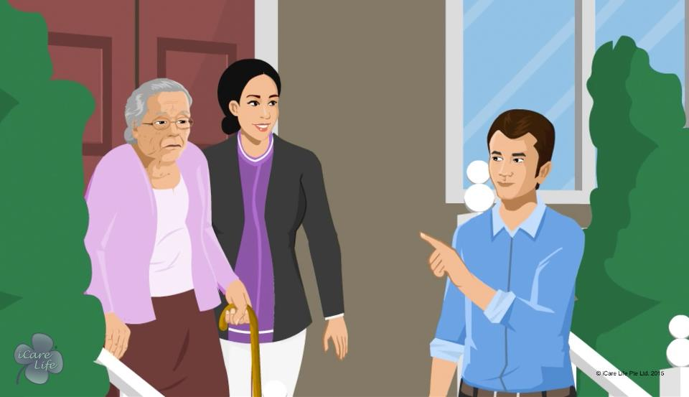
Fit in with Family Rules and Routines

Slide 13
Post-Module Activity
Case studies
12
Copyright: iCare Life Pte. Ltd., Singapore : This document must not be copied or shared or circulated without the consent of iCare Life and/or its affiliates.
Notes:
Divide the class participants into pairs. Print each of the following situations on a sheet of paper before the class starts. Do not print the answers.
The care receiver sleeps at 8 PM according to their schedule. What will you do if the family decides to take them out for a dinner outing and plan on returning at 10 PM?
The family has a ritual of fasting on Monday, every week. The care receiver’s health does not allow them to skip meals. What will you do in such a case?
You find that the care receiver’s room is full of furniture articles which are not used much. This makes it unsafe for the care receiver to move around the room. It also results in accumulation of dust which is not good for the care receiver’s health. What will you do in such a situation?
Give one situation to each pair. You can give one situation to more than 1 pair.
Ask each pair to discuss their situation and think of a right answer in 10 minutes. Now invite each pair to come forward and discuss their situation and answer with the class. Rest of the class participants can also provide inputs.
Correct answer 1- Allow the care receiver to go out with the family as minor adjustments can be allowed once in a while. Also, it is important for the care receiver to spend time with their family. If this occurrence happens more than what can be adjusted, then speak to the family about limiting late-night outings.
Correct answer 2- Skipping meals can be bad for care receiver’s health, especially if they are on medication. In such a case speak to the family. Explain that skipping meals are bad for care receiver’s health and allow to not fast.
Correct answer 3- You should first ask the care receiver if they want unnecessary articles to be removed from the room. If yes, then speak to the family about wanting to make some space in the care receiver’s room. Also, ask what procedure is followed in the rest of the house and where should the extra articles be stored.

Slide 14
Summary
Find out and follow the family’s rules and routines:
Around meals,
For activities such as going outdoors and watching television,
For family spending time together,
Around the volume of music and television, and
For cleaning the living space of the care receiver
Adjust the care receiver’s routine for participation in family occasions
Do not ridicule or disregard the family’s beliefs
If you want to make any changes to the cleaning procedures or reorganizing the living space, first check with your employer
If the family has any rules about handling money, understand and respect these rules
13
Copyright: iCare Life Pte. Ltd., Singapore : This document must not be copied or shared or circulated without the consent of iCare Life and/or its affiliates.
Notes:
Find out and follow the family’s rules and routines:
Around meals,
For activities such as going outdoors and watching television, and
For family spending time together,
Around the volume of music and television, and
For cleaning the living space of the care receiver
Adjust the care receiver’s routine for participation in family occasions
Do not ridicule or disregard the family’s beliefs
If you want to make any changes to the cleaning procedures or reorganizing the living space, first check with your employer
If the family has any rules about handling money, understand and respect these rules

Slide 15
Any Questions?
14
Copyright: iCare Life Pte. Ltd., Singapore : This document must not be copied or shared or circulated without the consent of iCare Life and/or its affiliates.
Notes:
Q1. How should I handle the money given to me for care receiver’s expenses?
Ans.
a) Maintain a small diary/notebook in which you can record the amount of money given to you and the respective dates.
b) Keep bills of the items purchased and record the purchases in you diary/ notebook.
c) If you buy any item which does not form part of the regular purchases, inform the family about it beforehand.
d) Always ask who you should speak to in case the money finishes.
Q2. How should I make sure that I remember and adjust according to the family’s routines?
Ans. Speak to the family members about any special activities which have to be considered. Make a note of these.
Also, observe the rest of the family for some days to understand the general routine.
Always look out for some time which the care receiver can spend with the family. It is very important for the care receiver and the family both.
Q3. How flexible should I be with care receiver’s routine?
Ans. Sticking to the routine is important, especially if the care receiver is not well and is on medication. However, being flexible once in a while can be allowed if it is not affecting the care receiver drastically. Also speak to the family if you cannot allow certain change in the routine. Inform them of the reason as well.

Slide 16
Understanding Family Structures
15
Copyright: iCare Life Pte. Ltd., Singapore : This document must not be copied or shared or circulated without the consent of iCare Life and/or its affiliates.

Slide 17
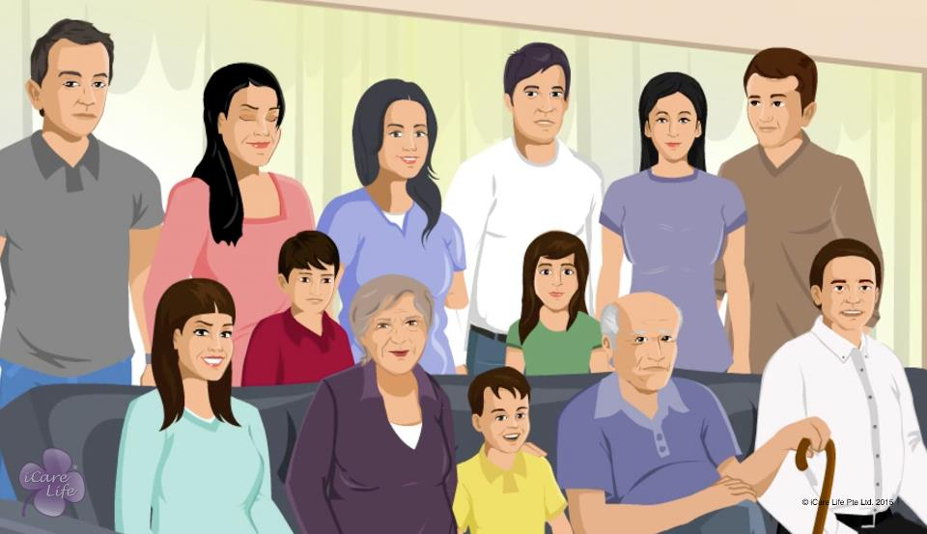
Understanding Family Structures

Slide 18
Summary
The main types of families in today’s society
Nuclear family,
Dual-career family,
Extended family,
Single parent family,
Bi-nuclear family, and
Blended family
17
Copyright: iCare Life Pte. Ltd., Singapore : This document must not be copied or shared or circulated without the consent of iCare Life and/or its affiliates.
Notes:
The main types of families in today’s society
Nuclear family,
Dual-career family,
Extended family,
Single parent family,
Bi-nuclear family, and
Blended family

Slide 19
Any Questions?
18
Copyright: iCare Life Pte. Ltd., Singapore : This document must not be copied or shared or circulated without the consent of iCare Life and/or its affiliates.
Notes:
Q1. What are the advantages of a nuclear or dual-career family?
Ans.
Dual income
Higher consistency in raising children
Stronger Emotional Bonds and Support Systems
Q2. What are the disadvantages of a nuclear or dual-career family?
Ans.
Isolation from other relatives and relationships
Mothers get overworked if the family does not have external help
Children tend to get neglected as one or both parents are working
Q3. What are the advantages of an extended family?
Ans.
Resources are utilized better
Children learn to adjust well
Emergencies can be taken care of well
Traditions and family values can be upheld
Children and grandparents remain close-knit
Q5. What are the disadvantages of an extended family?
Ans.
a) Resistance to change in value/education system of the family
b) Independence of the ladies in the household may get compromised upon
c) Hindrance in the development of individual personalities

Slide 20
Keeping the Family Informed and Involved
19
Copyright: iCare Life Pte. Ltd., Singapore : This document must not be copied or shared or circulated without the consent of iCare Life and/or its affiliates.

Slide 21
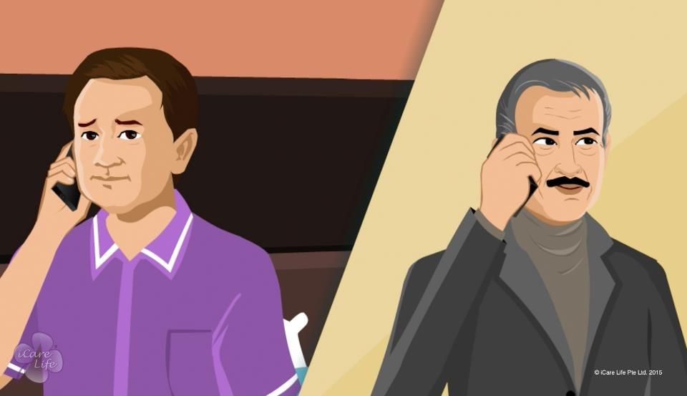
Keeping the Family Involved

Slide 22
Post-Module Activity
Events to Involve the Family
Event | Yes/ No
Elder slept for half an hour less today
Child fell down and bruised their knee
Elder made a good progress during evening walk today
Elder has lately been having trouble breathing
Baby soiled three diapers yesterday
Child’s water consumption has been very less in the last two days
Baby has been happy and is eating well
21
Copyright: iCare Life Pte. Ltd., Singapore : This document must not be copied or shared or circulated without the consent of iCare Life and/or its affiliates.
Notes:
Show the given table to the class and take their opinions on whether the activity/ incident should be reported to the family or not. Discuss why or why not for each option.
Answer key:
No
Yes
Yes
Yes
No
Yes
yes

Slide 23
Summary
At the start of your assignment, talk to your employer about the frequency of reporting
Maintain a daily log of the diet, activities, and health problems of the person
Record any purchases of grocery and medicines you have made
Document the doctor’s appointments, prescriptions, and medical records
22
Copyright: iCare Life Pte. Ltd., Singapore : This document must not be copied or shared or circulated without the consent of iCare Life and/or its affiliates.
Notes:
At the start of your assignment, talk to your employer about the frequency of reporting
Maintain a daily log of the diet, activities, and health problems of the person
Record any purchases of grocery and medicines you have made
Document the doctor’s appointments, prescriptions, and medical records

Slide 24
Summary
You must inform and involve the family:
If you notice a new health or emotional problem,
If the elder insists on smoking or drinking alcohol,
In choosing doctors or medical professionals for the person,
In taking a decision about any medical procedure or surgery that needs to be performed on the person,
When taking the person outside the house, and
If the person has an accident
23
Copyright: iCare Life Pte. Ltd., Singapore : This document must not be copied or shared or circulated without the consent of iCare Life and/or its affiliates.
Notes:
You must inform and involve the family:
If you notice a new health or emotional problem,
If the elder insists on smoking or drinking alcohol,
In choosing doctors or medical professionals for the person,
In taking a decision about any medical procedure or surgery that needs to be performed on the person,
When taking the person outside the house, and
If the person has an accident

Slide 25
Any Questions?
24
Copyright: iCare Life Pte. Ltd., Singapore : This document must not be copied or shared or circulated without the consent of iCare Life and/or its affiliates.
Notes:
Q1. What modes can be used to keep the record of daily activities?
Ans. One could maintain records in a diary, on an e-notebook, or a computer. One could devise a proper format/table to do so. This could help summarize the activities quickly and accurately without omitting any detail.
Q2. How often should one report to the family about the activities of the care receiver?
Ans. Normally the family should be able to give you a schedule or you may ask the family to give you a schedule if not given by them. Normally a report once in a day in the evening should keep the family well informed even if it does not change on a daily basis. It gives the family and the care receiver an assurance that all is well.
Q3. Would it be a good idea to let the care receiver speak to the family about their own condition if the family is in a different city?
Ans. Yes. Talking with the family members helps a sense of belongingness which works well for the care receiver as well as the family.
Q4. Should you just follow what the family has asked you to do or could one advise the family on the matters related to health and security of the care receiver?
Ans. Since you have the overall responsibility of the matters related to the care receiver, you could always offer your suggestions to the family members.. However, you should not carry it too far. One has to see the family response as to how open are they in receiving your suggestions.

Slide 26
Planning and Escorting to Doctor's Appointments
25
Copyright: iCare Life Pte. Ltd., Singapore : This document must not be copied or shared or circulated without the consent of iCare Life and/or its affiliates.

Slide 27
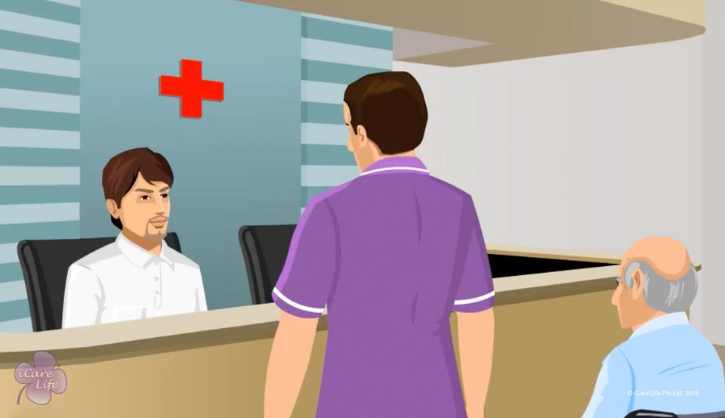
Escorting to Doctor's Appointments

Slide 28
Summary
Ask the person’s family for the details of the person’s doctor and the medical records
Take the elder’s consent about planning the doctor’s visit
Ask for the family’s consent for taking the person to the doctor
Secure the doctor’s appointment
Enquire about the doctor’s fees
Estimate the other expenses
Talk to your employer and ask them for the required money
Find out about the doctor’s address and route
Gather the person’s earlier prescriptions and medical reports
27
Copyright: iCare Life Pte. Ltd., Singapore : This document must not be copied or shared or circulated without the consent of iCare Life and/or its affiliates.
Notes:
Ask the person’s family for the details of the person’s doctor and the medical records
Take the elder’s consent about planning the doctor’s visit
Ask for the family’s consent for taking the person to the doctor
Secure the doctor’s appointment
Enquire about the doctor’s fees
Estimate the other expenses
Talk to your employer and ask them for the required money
Find out about the doctor’s address and route
Gather the person’s earlier prescriptions and medical reports

Slide 29
Summary
Gather other relevant documents such as daily logs and vital signs charts
Help the person get dressed in comfortable clothes and shoes
Start early and carry all documents
Carry an outing bag
When you reach the doctor’s clinic:
Settle the person comfortably
Inform the doctor’s staff of your arrival
Enquire about the procedure for making payments
Take the person to the restroom
After the doctor’s visit, buy medicines that the doctor may have prescribed
When you reach back home, ask the person to wash their hands with soap
28
Copyright: iCare Life Pte. Ltd., Singapore : This document must not be copied or shared or circulated without the consent of iCare Life and/or its affiliates.
Notes:
Gather other relevant documents such as daily logs and vital signs charts
Help the person get dressed in comfortable clothes and shoes
Start early and carry all documents
Carry an outing bag
When you reach the doctor’s clinic:
Settle the person comfortably
Inform the doctor’s staff of your arrival
Enquire about the procedure for making payments
Take the person to the restroom
After the doctor’s visit, buy medicines that the doctor may have prescribed
When you reach back home, ask the person to wash their hands with soap

Slide 30
Any Questions?
29
Copyright: iCare Life Pte. Ltd., Singapore : This document must not be copied or shared or circulated without the consent of iCare Life and/or its affiliates.
Notes:
Q1. What should you do if after you reach the clinic, you find that the doctor is not available for some reason despite your having made an appointment?
Ans. Such things though do not normally happen but there definitely could be circumstances where the doctor may get caught up in some emergencies. In such a case, you could either wait till the arrival of the doctor or take the next appointment in case of inordinate delays.
Q2. Should you let the care receiver speak for themselves to the doctor?
Ans. Yes. You could however give the doctor a brief from the log you maintain on behalf of the care receiver. You could also fill in those details which the care receiver has forgotten to mention. This is where the accurate log maintained by you comes in most handy. On the whole you should let the patient interact directly with the doctor as it gives a lot of confidence to the care receiver.
Q3. Can there be occasions where you may have to carry the care receiver in an ambulance?
Ans. Yes, there may be possibilities where depending upon the condition of the care receiver, you may have to call for an ambulance. This may sometimes happen in case of emergencies. Similar to taking the appointment, you should try and call the ambulance well in time.

Slide 31
Communicating with Doctors, Nurses, and other Medical Staff
30
Copyright: iCare Life Pte. Ltd., Singapore : This document must not be copied or shared or circulated without the consent of iCare Life and/or its affiliates.

Slide 32
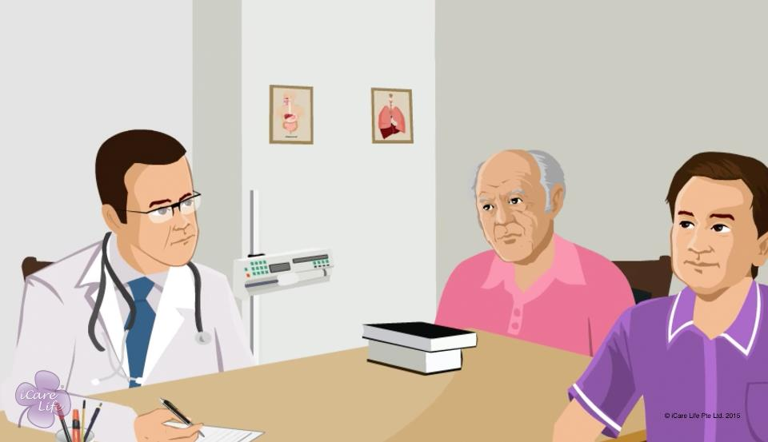
Communicating with Doctors

Slide 33
Post-Module Activity
Role-play and discussion
Group A- Doctors | Group B- Caregivers
Doctor asks questions about care-receiver’s son’s life | How should the caregiver react?
Doctor explains the dosage and timings of medication | The caregiver did not understand the instructions well. How should they react?
Doctor examines the care receiver and explains symptoms to the caregiver and urgency of treatment | The caregiver is not in a capacity of taking decisions. What should they do?
32
Copyright: iCare Life Pte. Ltd., Singapore : This document must not be copied or shared or circulated without the consent of iCare Life and/or its affiliates.
Notes:
Make two groups of 3 participants each. Group A would play the roles of doctors and group B would play the roles of caregivers.
Ask one participant to come forward from each group and give them following situations to act according to. The rest of the class can give inputs on what should be the right behavior.
Ans 1. Caregiver should politely decline giving answers to any personal questions and direct the doctor to a family member.
Ans 2. Caregiver should request the doctor to explain dosages and timings again. Also, they can take some notes if needed. Make sure that the instructions are repeated in front of the doctor so that nothing important is missed.
Ans 3. Caregiver should immediately speak to a family member and tell them about the diagnosis and urgency of treatment, as told by the doctor. Also, request the family member to speak to the doctor about the same.

Slide 34
Summary
Be courteous to the medical professional
Interact with them in a professional manner
Keep the medical records handy
Limit your conversation to matters regarding the health of the person under your care
Talk only when you are spoken to
Do not interfere with the medical professional’s work
Give short and clear answers to questions
Understand, note down, and reconfirm instructions
33
Copyright: iCare Life Pte. Ltd., Singapore : This document must not be copied or shared or circulated without the consent of iCare Life and/or its affiliates.
Notes:
Be courteous to the medical professional
Interact with them in a professional manner
Keep the medical records handy
Limit your conversation to matters regarding the health of the person under your care
Talk only when you are spoken to
Do not interfere with the medical professional’s work
Give short and clear answers to questions
Understand, note down, and reconfirm instructions

Slide 35
Any Questions?
34
Copyright: iCare Life Pte. Ltd., Singapore : This document must not be copied or shared or circulated without the consent of iCare Life and/or its affiliates.
Notes:
Q1. How should I reply if the doctor/nurse asks some personal questions related to the care receiver’s family matters?
Ans. Politely decline answering the question. Direct the doctor or the nurse to the family member for further clarification by saying “may be a family member will be able to give you more information about this”. Refrain from revealing any personal information of the family.
Q2. How do I handle questions related to the care receiver’s illness if I do not have the right answers or information?
Ans. Tell the doctor/nurse/physiotherapist/technician that you are not aware of the right answer. Assure them that you will get back with the right information. Speak to the family members and let them know about the questions. If you are not confident in answering the questions, request the family members to step in the situation and talk. Be sure that you do not give incorrect answers in any situation.

Slide 36
Keeping Track of Bills
35
Copyright: iCare Life Pte. Ltd., Singapore : This document must not be copied or shared or circulated without the consent of iCare Life and/or its affiliates.

Slide 37
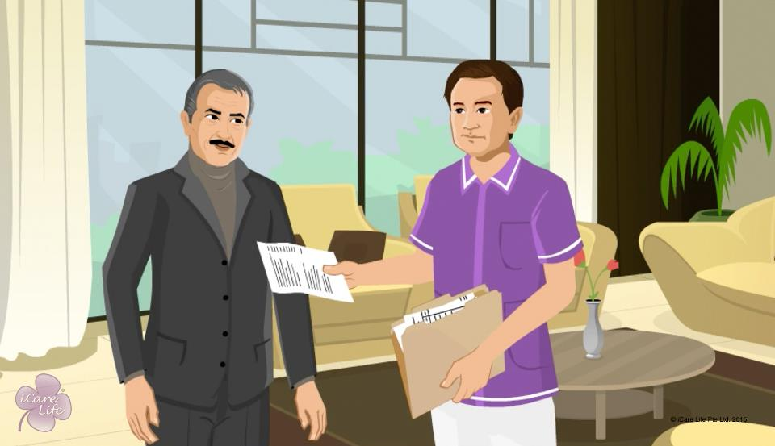
Keeping Track of Bills

Slide 38
Post-Module Activity
Money Accounting
Day/ Date | Expense | Amount received | Amount spent
37
Copyright: iCare Life Pte. Ltd., Singapore : This document must not be copied or shared or circulated without the consent of iCare Life and/or its affiliates.
Notes:
For this activity:
Print the given instructions and table for every class participant and one for yourself
Arrange for a white board and a marker
Explain to the class that they have to calculate a week’s expenditure of an elder based on the instructions. Explain that this is only an example.
Instructions:
Monday-
Currency received by caregiver- 300
Refill of medicines- 20
Bought material for elder’s hobby class- 15
Tuesday-
Home visit by doctor- 100
Wednesday
Rented a movie DVD for the elder- 20
Bought a book for the elder- 70
Thursday-
Money received by caregiver- 300
Elder’s medical test- 150
Friday-
Bought some personal use items for the elder- 80
Saturday- Paid the elder’s phone bill- 120
Sunday- Bought a cake for elder’s birthday- 100
After the class participants have finished their calculations, solve the question on the white board.
Answer- 75 left with the caregiver

Slide 39
Summary
Check who is responsible for paying the telephone, electricity, and other utility bills
In case the person responsible for keeping track of the bills is not available, note the due dates in your monthly planner
File the bills and receipts after the payment has been made
Check who is responsible for buying grocery and other supplies for the elder
Keep a check on the availability of grocery items used for the elder
Hand over a weekly list of required items to the person responsible for buying grocery
Ask your employer about who will buy the elder’s medicines
Every week, make a list of medicines that need to be bought
When handling money and making purchases, keep and file all the bills
Note down the date and amount of each transaction and provide this log and the bills to your employer
38
Copyright: iCare Life Pte. Ltd., Singapore : This document must not be copied or shared or circulated without the consent of iCare Life and/or its affiliates.
Notes:
Check who is responsible for paying the telephone, electricity, and other utility bills
In case the person responsible for keeping track of the bills is not available, note the due dates in your monthly planner
File the bills and receipts after the payment has been made
Check who is responsible for buying grocery and other supplies for the elder
Keep a check on the availability of grocery items used for the elder
Hand over a weekly list of required items to the person responsible for buying grocery
Ask your employer about who will buy the elder’s medicines
Every week, make a list of medicines that need to be bought
When handling money and making purchases, keep and file all the bills
Note down the date and amount of each transaction and provide this log and the bills to your employer

Slide 40
Any Questions?
39
Copyright: iCare Life Pte. Ltd., Singapore : This document must not be copied or shared or circulated without the consent of iCare Life and/or its affiliates.
Notes:
Q1. Why may the employer give me the responsibility of making purchases for the care receiver?
Ans. An employer may task you to make purchases because: -
(a) The employer may not have time to do the same
(b) The employer may develop the confidence in your services and may delegate you the responsibility
(d) It may be a part of contract with your principal employer
Q2. Should you ask the employer if they would want you to make purchases from particular vendors?
Ans. This would be advisable as the employer may have preferred supermarkets or shops from where they usually make purchases.
Q3. How important is it to keep a good record of the purchases made by you?
Ans. It is extremely important to do so as maintaining good record is an expression of your integrity and it builds a good rapport between you and the employer. When you enjoy the trust of the care receiver, it helps you keeping the working atmosphere light and enjoyable.

Slide 41
Summary
Chronologically, an elder may be:
The Almost Old
The Already Old
The Very Old
The Elite Old
Everyone of a particular age does not have the same physical, mental, or social ability
These days elders are healthier
Being Old - is more a state of mind than a certain age
40
Copyright: iCare Life Pte. Ltd., Singapore : This document must not be copied or shared or circulated without the consent of iCare Life and/or its affiliates.
Notes:
Chronologically, an elder may be:
The Almost Old
The Already Old
The Very Old
The Elite Old
Everyone of a particular age does not have the same physical, mental, or social ability
These days elders are healthier
Being Old - is more a state of mind than a certain age

Slide 42
Any Questions?
41
Copyright: iCare Life Pte. Ltd., Singapore : This document must not be copied or shared or circulated without the consent of iCare Life and/or its affiliates.
Notes:
Q.1. What should I do if the elder wants to do activities such as rigorous exercising that I feel they are too old to do?
Ans. See if the elder is comfortable doing the exercise. You may even check with the family and the elder’s doctor. If not, gently explain to the elder that they while it is good to exercise regularly, they should do so within limits prescribed by their doctor.

Slide 43


